Slide 1
Needs and Guidance of Children

Slide 2
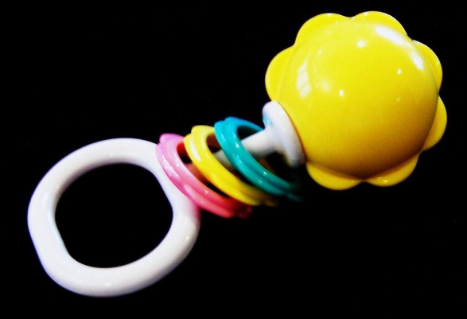
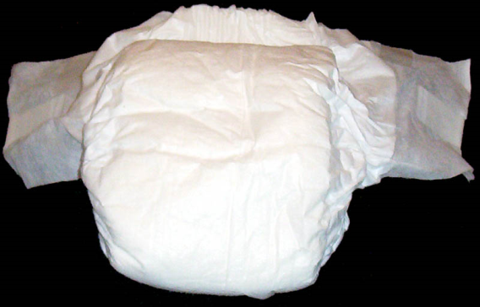
Notes:
Which of the items pictured would be appropriate for someone your age?
Which would be appropriate for a baby?
Each age group has different needs.
A golf club would be dangerous for a baby, but you would enjoy the sport.
There are other needs that people have. We all have mental, emotional, and physical needs.
Young children’s needs change quickly because they are developing so quickly.

Slide 3
Children’s Needs
Notes:
Each child is special and different, yet every child follows a certain pattern or order of growth and development.
Many things can affect the way a child follows these growth patterns.
Heredity, nutrition, and surroundings all affect the way children grow.
Family love and attention are important factors.
The words normal and average tell what is true of most people or children.
However, there will always be some individuals who grow and develop more slowly or more quickly than what is considered normal or average.
Each area considers the physical, mental and emotional needs of the child.

Slide 4
Physical Needs
Notes:
It takes time and effort for the child to gain control of his/her body.
Have the students take a piece of paper and put it on top of their heads.
Now ask them to draw a picture of a cow.
Does it really look like a cow?
If you practiced this over and over, you could perhaps get quite good at drawing the cow.
It takes time and practice for the child to gain control of his/her muscles and do what she/he wants them to do.

Slide 5
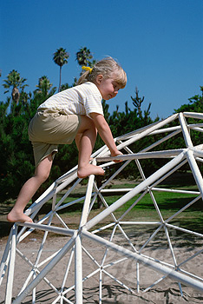
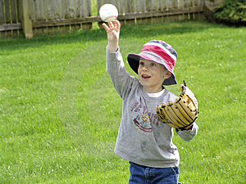
Large Motor Skills
Jumping
Running
Climbing
Throwing
Notes:
The pre-schooler is very physical. She/he has gained control of his/her body. Now he/she wants to use it. She/he wants to become strong and skilled.
She/he needs to practice running, jumping, climbing, hopping, kicking, throwing, and catching.
These are called large motor skills.

Slide 6
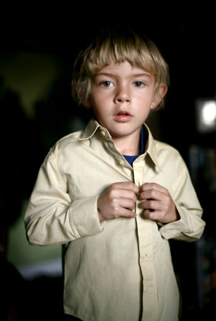
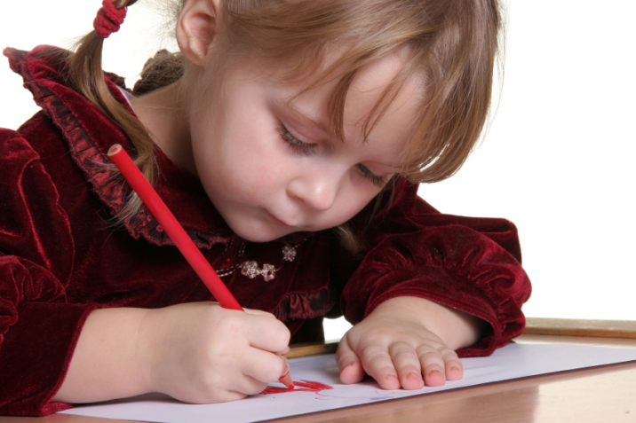
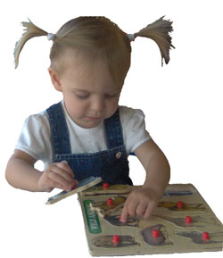
Small Motor Skills
Dressing
Drawing and Coloring
Toys
Notes:
The pre-schooler also needs to improve his/her small motor skills – abilities to use hands and fingers well.
Dressing
Let the young child dress themselves.
Give them large zippers and big buttons.
Belt buckles and snaps are too hard for them to handle, but pullover shirts and pants with elastic waistbands are easily pulled on.
Drawing and Coloring
Give the child lots of practice in drawing and coloring with large crayons, fat pencils, water-washable felt-tip pens, colored chalk, fingerprints, washable water-based paints, newsprint, inexpensive drawing paper, rolls of wrapping paper, clipboards, easels and fat brushes.
As the child becomes skilled with these, include smaller versions.
They are developing the hand and finger muscles needed later when it is time to learn to write.
Toys
The young child needs practice using smaller toys than the toddler could handle.
Puzzles, small blocks, lacing toys, and small cars are good choices.

Slide 7
Mental Needs
Pronouns are difficult
May use incorrect grammar
“Why?”
Books
Notes:
The preschooler uses language very well. He makes some mistakes in grammar and does not pronounce every word correctly; however, he knows a large number of words. You can encourage language development by encouraging him to talk and express his ideas. Listen to what he says and then respond with new words that he does not know yet.
Pronouns are very difficult for the young child. Words like I, me, you, him, and she are confusing.
The young child may use incorrect grammar. Do not tell her she is wrong. Simply repeat the sentence back correctly to her so that she understands the correct usage of the words.
Why becomes the preschooler’s favorite word. Every sentence you utter is questioned with a “Why?” by the child. Try to help him keep his curiosity by giving brief explanations. Turn the question back to him: “Why do you think?”, or if you do not know the answer, you could both look for the answer in a book.
Books are very important to the preschooler. Have lots of picture books around for the child to look at by himself, or for you to look at together. Talking about the pictures helps him to get ready for reading.

Slide 8
Emotional Needs
Touching
Children need love
Notes:
Touching is a natural, easy way to show children they are loved and needed. Touching, as communication between parents and children, is more than hugging and kissing. It can be a pat on the shoulder or a gentle poke in the ribs. We never outgrow our need to be touched.
Children need love in order to grow into healthy, self-confident adults. The love parents and other family members give should be unconditional. That means loving them all the time, nom matter what they may say, do, or look like. It also means separating what they do from who they are. You can be angry at a child's behavior without making the child feel unloved. Say, “I am angry that you threw the flour all over the floor” instead of “You are a bad boy”. Of all the child’s needs, physical, mental and emotional, love may be the most important of all.

Slide 9
Types of Child Abuse
Physical Abuse
Sexual Abuse
Emotional Abuse
Neglect
Notes:
Physical - Any injury or wound that is inflicted on the child with intention
Sexual - It is defined as any act of sex between a child and an adult.
Psychological - Any attitude, talk or expression that is demeaning and degrading for your child falls in this category. If your child has been screamed at, called names or called inferior to other children, he is a victim of emotional abuse. Any kind of emotional abuse has a long-lasting effect on the all round development of your child.
Neglect - If the basic needs and requirements of a child are not being fulfilled, he is a victim of neglect. If a child does not get proper affection, care, food, clothing, medicine or supervision, he can be called a neglected child.

Slide 10
Signs of Child Abuse
Unexplained bruises, welts, burns, fractures that repeatedly occur.
Hostile and aggressive, withdrawn, poor self-image.
Begging or steeling food, constant fatigue, failing to attend school

Slide 11
Prevention of Child Abuse
Strengthen the family through:
Communication skills
Decision making skills
Conflict resolution skills
Encourage family members to develop:
Develop self-esteem
Self-acceptance
Self-control
Professional family counselor

Slide 12
Child Care Quiz
Take the Child Care Quiz to see what you know!
Notes:
Hand out the Child Care Quiz for the students to complete.
When they are finished, review the answers with them.

Slide 13
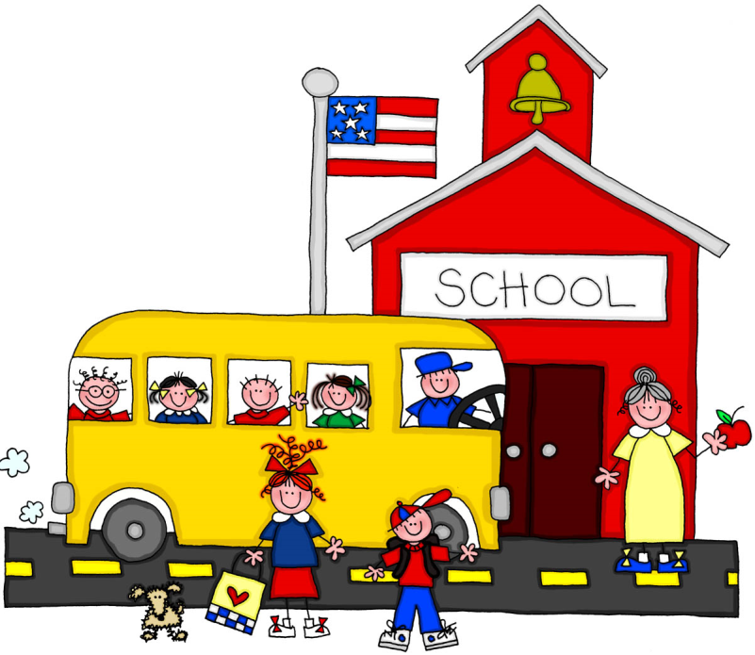
Guidance
What are some of the methods of discipline used in our school?
Are the rules effective?
Do the students know what is expected of them?
Notes:
Explain why the rules were made and how they are enforced.
Just as students need rules for behavior, so do children.
Guidance is a term that means discipline. It is a positive approach to establishing rules and keeping the children in control.

Slide 14
Guiding the Child
Mental and emotional needs
Teaching and limiting
More than rules of behavior
Live what you want to teach
Notes:
The mental and emotional needs of children are often more difficult to think of and remember than the physical needs. To get along in the world, children need some basic guidelines for behavior. We have the responsibility to teach children how to behave. The word discipline comes from the word disciple, which means student or follower. To teach guidelines successfully, begin with encouragement, love, and praise. Children repeat actions they are praised for and give up any actions that are ignored by others.
Discipline is really a matter of teaching and limiting. The child learns discipline from your example, from your respectful acceptance of her/him, from your encouragement of her/his achievements, and from the limits you set on his/her impulsive actions.
Discipline is more than rules of behavior. It is a process of gradually imparting your values about living and your sense of the meaning and purpose of living to the thick. It is your sense of showing children that, in growing up, it is often desirable to delay or give up immediate personal interest for something that will mean more later.
The heart of discipline is trying to live what you want to teach. Children cannot be taught merely by having you constantly correcting their actions. If you do not live what you teach, children will not pay much attention to what you say.

Slide 15
Positive Statements
Aren’t you going to drink your milk?
Don’t go out in the street.
Get your blocks out of the way!
Don’t get paint on the table.
That doesn’t look much like a dog.
You’re going to spill that water!
Notes:
Using words in guiding children can be helpful or confusing, according to our choice of phrases. Many children develop a protective deafness against adult directions because they hear too many of them.
In helping young children learn through verbal directions, one must first get the children’s attention. Then use clear, short, meaningful phrases that are expected and encouraging. Directions should be positive rather than negative inform, and always specific.
Have the students change these negative statements into positive statements:
You can hold your glass by yourself.
We stay inside the fence and play.
Let’s stack the blocks on this shelf.
We just paint on the paper.
Isn’t that a pretty red.
Hold the pitcher steady and pour slowly.

Slide 16
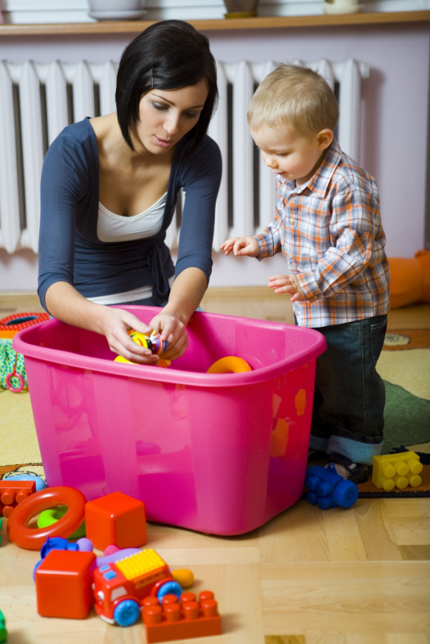
Discipline Guidelines
Give reasons and explanations for rules.
State guidelines positively.
Allow children time to follow instructions.
Spend time with the child.
Ignore poor behavior when possible.
Notes:
Give reasons and explanations for rules.
You need to buckle up your seat belt so if I have to stop suddenly, you will not go through the window.
State guidelines positively.
Keep the sand in the sandbox.
Allow children time to follow instructions.
In five minutes it will be time to clean up the toys and get ready for bed.
Spend time with the child.
I will pick up these books while you put the crayons back on the shelf.
Ignore poor behavior when possible.
You’re sitting so quietly.

Slide 17
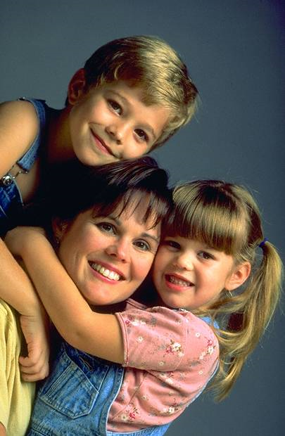
Discipline Guidelines
Follow through.
Redirect activity.
Speak directly to the child.
Do not compare children with each other.
Be honest with the child.
Notes:
Follow through.
You were supposed to come in the house. Now I will have to help you come in.
Redirect activity.
Here is your pounding table.
Speak directly to the child.
Get on the child’s level when speaking. Do not call across the room.
Do not compare children with each other.
This encourages resentment and inferiority.
Be honest with the child.
Do not promise anything if you cannot follow through.

Slide 18
Summary
Be aware of the physical, metal and emotional needs of the children you are caring for.
Guidance is necessary if you wish to have things run smoothly and accomplish the tasks you would like to accomplish.
Guidance must be done with love.

